Slide 1
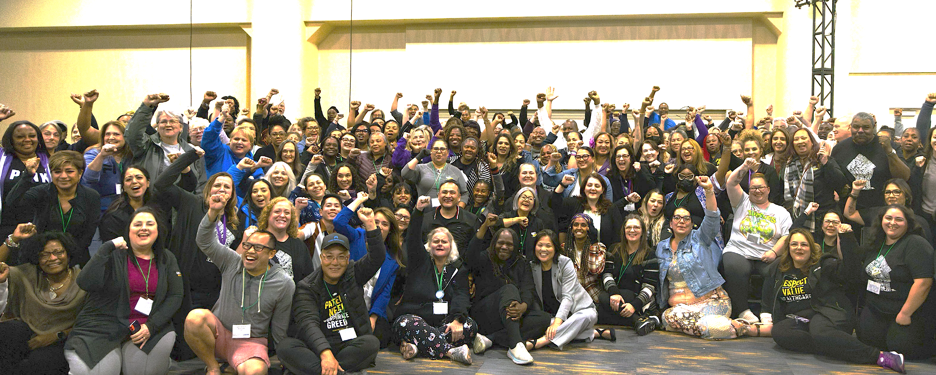
WE HAVE AN AGREEMENT!
OUR MEMBER-ELECTED 2023
KAISER BARGAINING TEAM

Slide 2
After our historic three-day strike, we have reached an agreement that wins on all our priorities:
Raises healthcare worker pay by 21% over the next four years, institutes a $23 (ROCs)
or $25 (CA) minimum wage
Includes a full menu of initiatives to invest in the workforce and address the short-staffing crisis
Protects our pensions and medical benefits, and improves retiree medical
Maintains the full value of our PSP, including minimum payouts we can count on when we meet goals

Slide 3
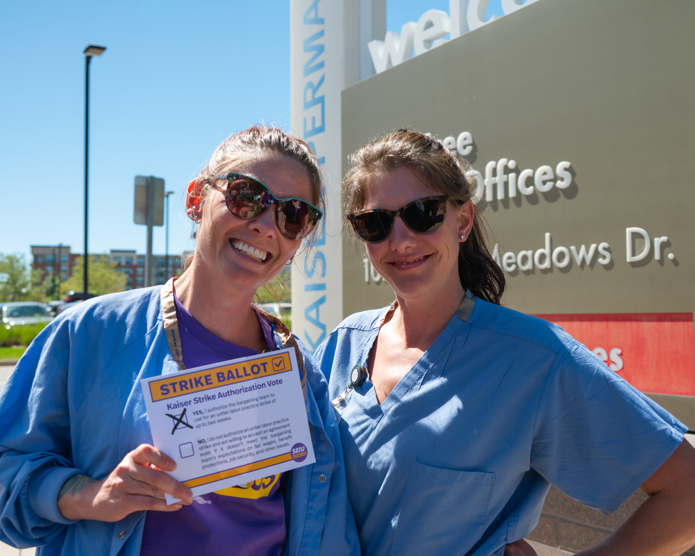
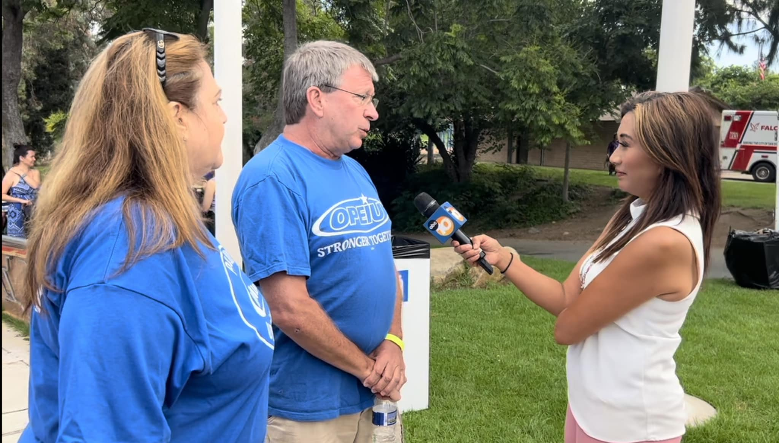
OUR STRATEGY TO WIN A STRONG CONTRACT:
WE GOT STRIKE READY
WE BUILT PUBLIC SUPPORT

Slide 4
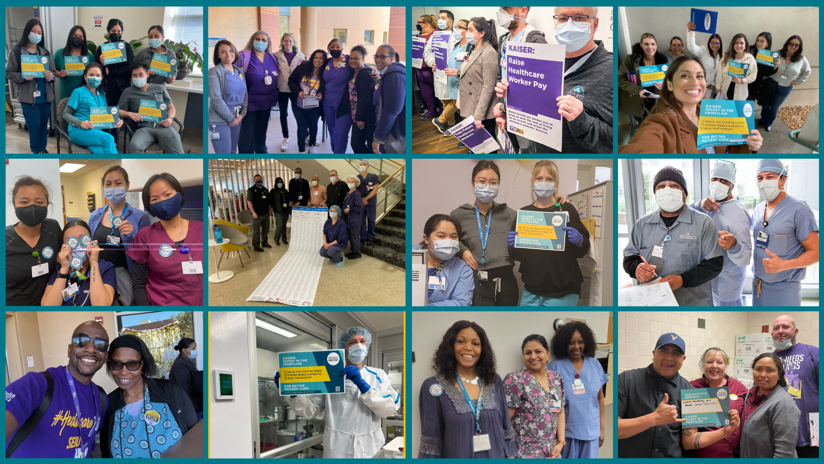
WE TOOK ACTION AFTER ACTION TO SHOW KAISER WE WERE SERIOUS...
… BUT THEY STILL WEREN’T LISTENING TO US.

Slide 5
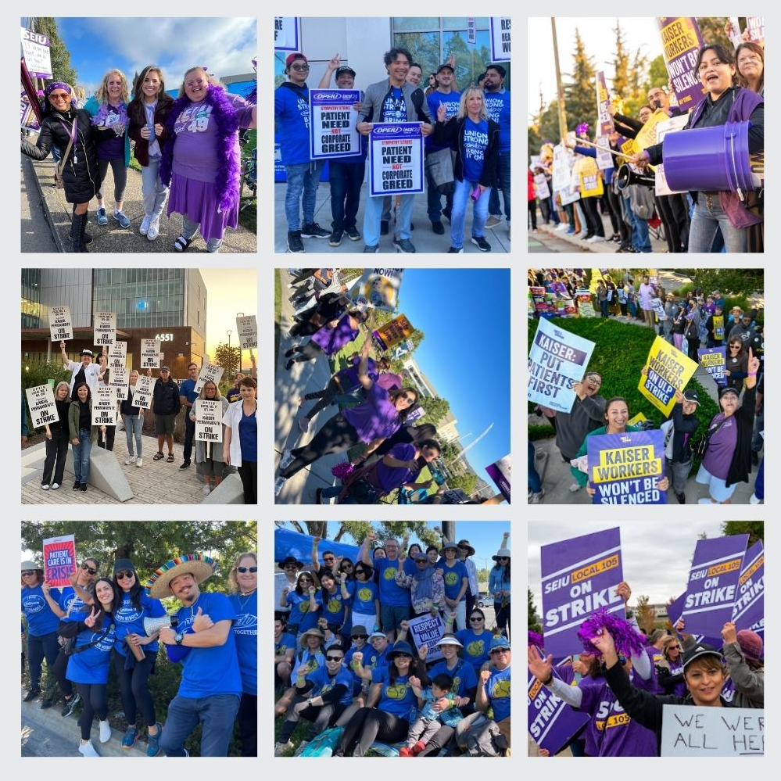
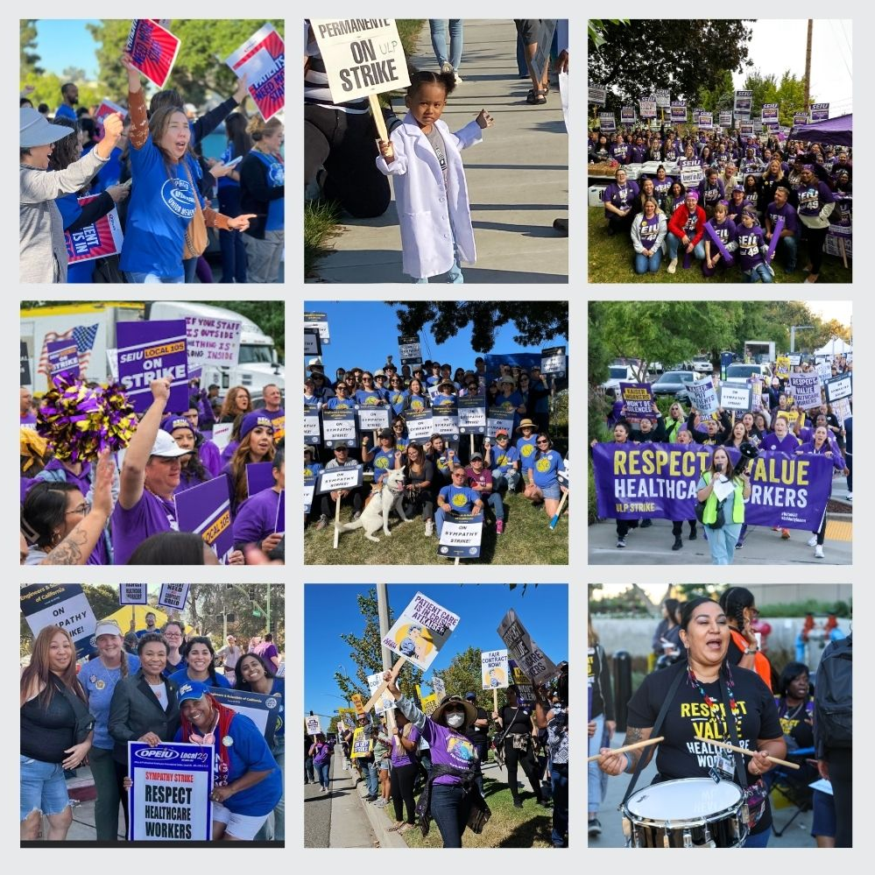
UNTIL WE MADE HISTORY WITH
THE LARGEST HEALTHCARE STRIKE EVER
Watch: 2023 Coalition of Kaiser Permanente Unions Strike - News Coverage

Slide 6
WHAT WE WON
RAISES
10/1/23 | 10/1/24 | 10/1/25 | 10/1/26
6% | 5% | 5% | 5%
RATIFICATION BONUS:
$1,500 one-time ratification bonus for all workers.
MINIMUM WAGE
 | 6/1/24 | 6/1/25 | 6/1/26
CA | $23/hr | $24/hr | $25/hr
Regions Outside CA | $21/hr | $22/hr | $23/hr

Slide 7
WHAT WE WON:
STAFFING
Protection from outsourcing and subcontracting for all positions. Defeated Kaiser’s attempt to outsource Revenue Cycle positions.
40% Increase to the Education Fund to provide education support, externships and preceptorship to help current employees promote into higher paid classifications.
Commitment to reducing registry/travelers and clarify that travelers are not used for day to day workflows.
$100 million in new investment in Futuro Health over the 4 year period to train healthcare workers of the future with plans to expand nationally. Annual installments are tied to meeting goals on graduates. Futuro graduates will be given preference for hiring over equally qualified external candidates.
EDUCATION OPPORTUNITIES FOR YOU AND YOUR FAMILY

Slide 8
WHAT WE WON:
STAFFING
Focus on recruiting and training current employees for key hard to fill positions.
During a one year period following ratification, with exceptions for promotions and FTE increases, new hires and people who transfer will commit to their position for one year in order to reduce internal churn and get to outside hiring faster.
Commitment to a timeline to implement joint staffing process system-wide, as outlined in Section 1F of the National Agreement, so we have an ongoing voice in determining staffing in our units/departments.
Increased protections for workers who have been remote for five years or more.
New remote worker policy that protects rights of remote and hybrid workers.

Slide 9
WHAT WE WON:
HEALTHCARE & RETIREMENT
No changes to employee healthcare and retirement benefits.
For the Post-2028 retiree medical plan, 25% increase in Health Reimbursement Account (HRA) contributions for $2000 per year of service to $2500 per year of service.
50% increase in additional infusion into HRA at age 85 from $10,000 into $15,000.
Allow premium subsidy to be used for any non- zero premium KPSA plan in the region, not only the lowest cost plan.
Full inclusion of our Coalition Partners in Washington State in our retiree medical plan.

Slide 10
WHAT WE WON:
2023 PSP
Our 2023 PSP, which will pay out in March 2024, will have a guaranteed minimum of $1500
(pro-rated for part time)
2024 PSP (and beyond)
If Kaiser fails to meet financial goals, members will be paid $300 per each labor goal met
(up to $1,200 for four labor goals)*
If Kaiser meets financial goals, members will be paid $700 per each labor goal met
(total potential payout of $2,800).
If Kaiser strongly exceeds financial goals, members will be paid $950 per each labor goal met
(total potential payout of $3,750)
*Enterprise must have a -2% margin or greater to fund full PSP; if below -2% margin can still earn 50% of performance goals ($600)
Goals and metrics are already set, allowing more time to focus on achievement:
Controlling High Blood Pressure, Member Flu Vaccination Rate, HCAHPS: Likelihood to Recommend, CAHPS Meteor Care Experience, and Regional Attendance.

Slide 11
98.5% YES RATIFIES NEW NATIONAL AGREEMENT
This is the strongest contract we’ve seen at Kaiser since we started the Partnership 25 years ago.
LET’S KEEP THE MOMENTUM GOING

